Slide 1
Lecture 2: Filters
Tom Jhou

Slide 2
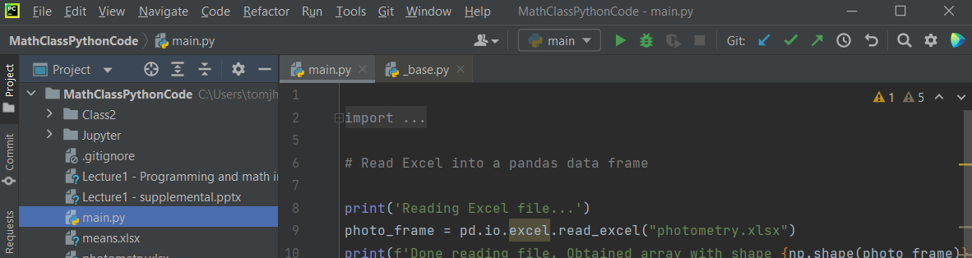
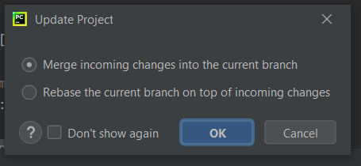
A few things before we start:
Update project using PyCharm’s blue arrow:
Accept default, click OK

Slide 3

Launch Anaconda, then Jupyter:

Slide 4

If it gets stuck, launch from start menu …:

Slide 5
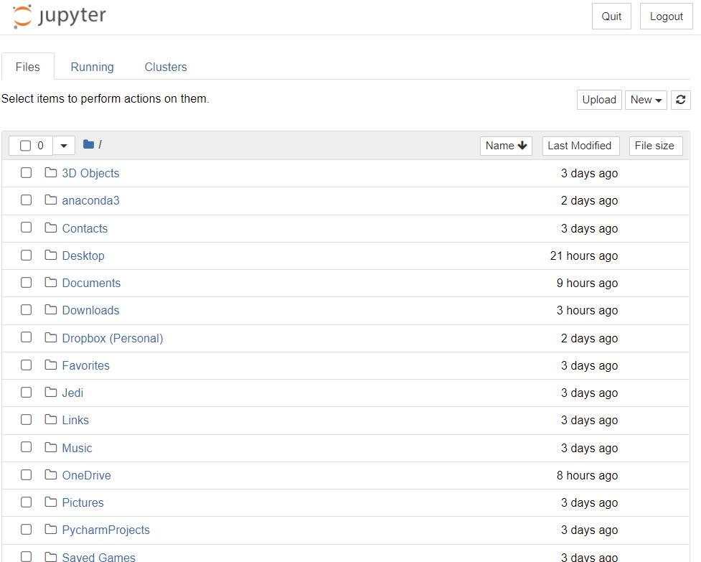
You should see your home folder:

Slide 6
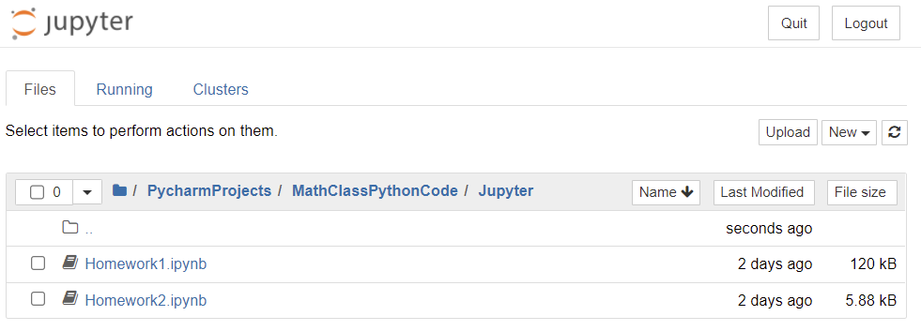
Navigate to Homework1.ipynb:

Slide 7
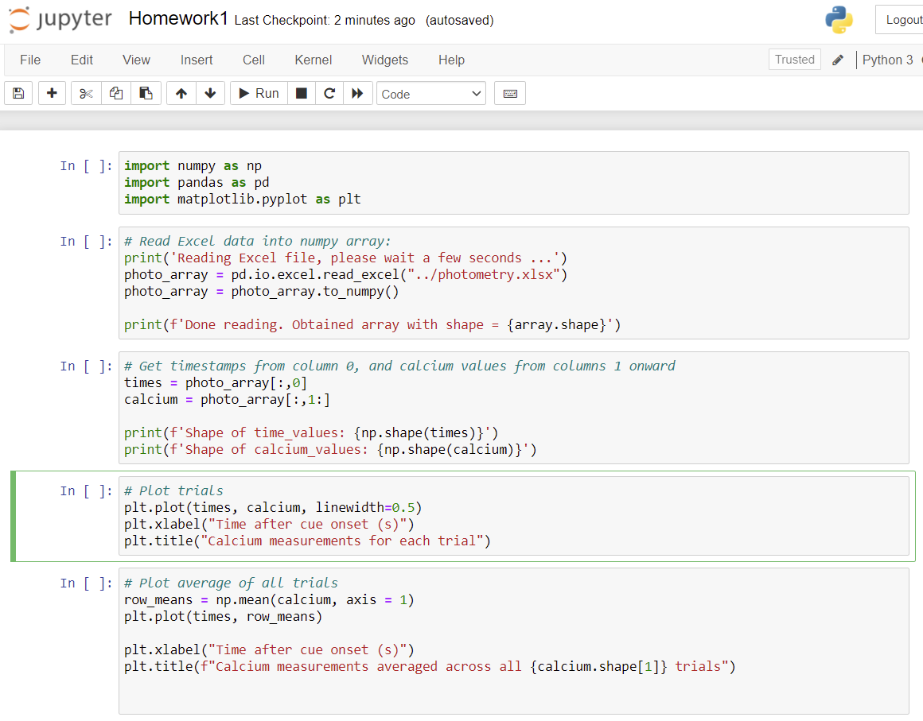

Slide 8
Now back to our regularly scheduled programming…

Slide 9


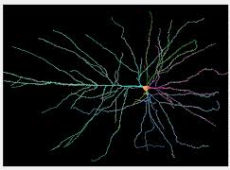
Filters enhance signals, reduce noise:
Found everywhere:
Sound/video processing: microphones, cameras, medical equipment, etc.
Analysis software
Biological systems (visual and auditory cortex)

Slide 10
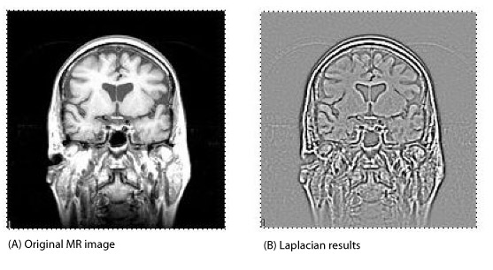

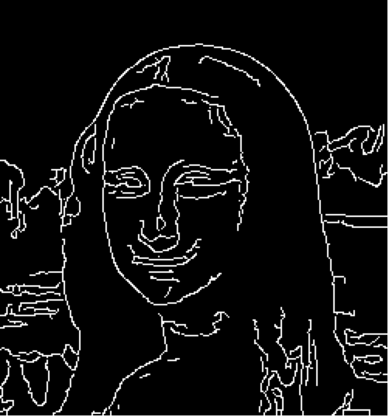
Imaging examples:
“Edge detection” filter
Notes:
This works like a charm. Before filtering, the background noise ranges over several millivolts, while spikes are only about 300 microvolts.
After filtering, background noise is about 100 microvolts, while spikes are still about 300 microvolts.
We removed a lot of stuff, and drastically reduced the background noise while spikes are almost the same height as before.

Slide 11
Example: neural spike detection:
Notes:
This works like a charm. Before filtering, the background noise ranges over several millivolts, while spikes are only about 300 microvolts.
After filtering, background noise is about 100 microvolts, while spikes are still about 300 microvolts.
We removed a lot of stuff, and drastically reduced the background noise while spikes are almost the same height as before.

Slide 12
Today will discuss only “linear” filters.
These have certain mathematical properties that make them “well-behaved”.
Sound, electrical waves, light, all behave linearly at normal intensity levels.

Slide 13
Filters remove noise. But what is “noise”?
Depends on your goal.
“Noise” in one experiment may be “signal” in another.

Slide 14
Example: find action potentials in brain recording
Notes:
There are fast wiggles and slow wiggles. The background noise tends to have lots of slow wiggles, the spikes tend to have lots of fast wiggles. We can use this to our advantage.
There are 20,000 points shown. The sampling rate is 31.25kHz, so this is about 2/3 of a second in the top part, and 1/8 second in the bottom part.

Slide 15
Perform “spectral analysis” of spikes vs noise
Background “noise”
Spikes
Notes:
“Noise” is in quotation marks because it actually is a brain signal. It comes from neurons that are too far away from recording wire to be resolved independently.

Slide 16
Noise is predominantly low-frequency. If we remove it, spikes will “stick out” more.
Background “noise”
Spikes
Notes:
“Noise” is in quotation marks because it actually is a brain signal. It comes from neurons that are too far away from recording wire to be resolved independently.

Slide 17
How did we do this frequency analysis? FFT = “Fast Fourier Transform”
import numpy as np
y = np.fft.fft(waveform);
waveform = list of voltages at regular time intervals
y = list of amplitudes at regular frequency intervals
Notes:
The function is easy to call, but you have to pay careful attention to the details of the frequencies that come out.

Slide 18
FFT of sine wave …
Input is a 1-second segment of a
5 Hz sine wave, sampled at 100Hz
FFT has peaks at 5 Hz and 95 Hz
5Hz makes sense. Ignore the 95Hz peak for now. Will explain in a few minutes.
waveform
FFT
Notes:
The function is easy to call, but you have to pay careful attention to the details of the frequencies that come out.

Slide 19
FFT of square wave:
Input is 5 Hz square wave, sampled at 100Hz
FFT has peaks at odd multiples of 5Hz: 5, 15, 25, et … Hz
Note symmetry at 50Hz
waveform
FFT
Notes:
The function is easy to call, but you have to pay careful attention to the details of the frequencies that come out.

Slide 20
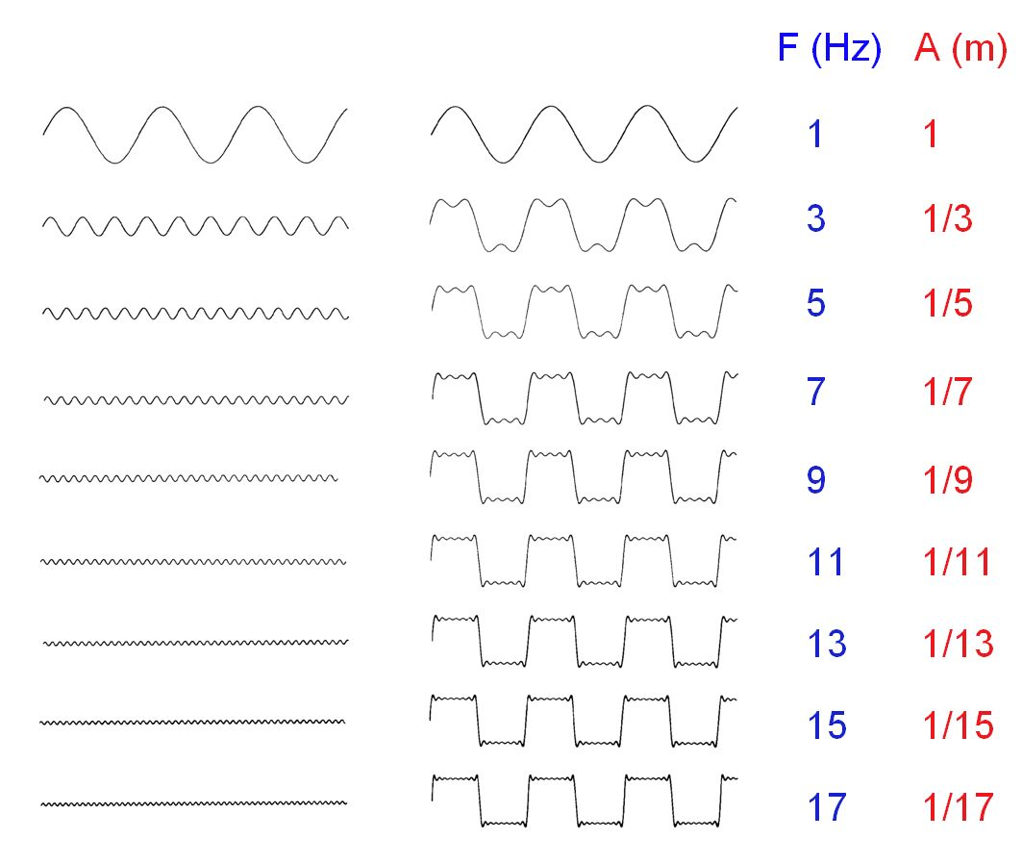
Square wave can be viewed as an infinite sum of sinusoids
Amplitude
Notes:
Note that the sine wave amplitudes are exactly inversely proportional to the frequency, i.e. they get smaller as frequency goes up. The “discrepancy” between sinusoidal sum and “true” square wave gets smaller and smaller as well.

Slide 21
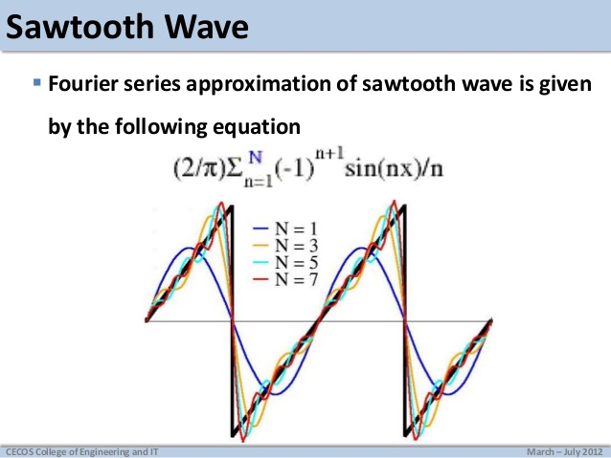
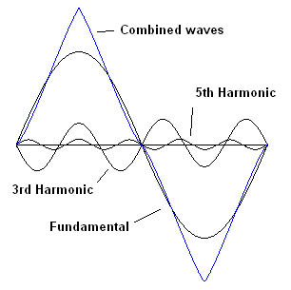
By altering phase, amplitude, we can get triangle, sawtooth waves
Square wave: odd harmonics, nth harmonic has amplitude 1/n.
Triangle wave: odd harmonics, amplitude 1/n²
Sawtooth: sines instead of cosines, odds + evens
Notes:
Note that the sine wave amplitudes are exactly inversely proportional to the frequency, i.e. they get smaller as frequency goes up. The “discrepancy” between sinusoidal sum and “true” square wave gets smaller and smaller as well.

Slide 22
By modifying phase and amplitude, can build any waveform
https://www.youtube.com/watch?v=ds0cmAV-Yek
Notes:
Destin doesn’t explain one very critical item, which is that the rotational speeds of the various circles are all FIXED INTEGER MULTIPLES of each other. The first circle rotates at some constant speed. The second circle rotates at twice that speed, the third circle rotates at 3 times the speed, and so on. The shape is entirely defined by the diameters (amplitudes) of the circles.

Slide 23
FFT of neural recording
EEG
Spikes
Notes:
There are fast wiggles and slow wiggles. The background noise tends to have lots of slow wiggles, the spikes tend to have lots of fast wiggles. We can use this to our advantage.
There are 20,000 points shown. The sampling rate is 31.25kHz, so this is about 2/3 of a second in the top part, and 1/8 second in the bottom part.

Slide 24
Log vs Linear axes:
Log axes – can see small numbers well
Linear axes
(small numbers all smushed together)
EEG
EEG
Spikes
Spikes
Notes:
“Noise” is in quotation marks because it actually is a brain signal. It comes from neurons that are too far away from recording wire to be resolved independently.

Slide 25
Linear axes show absolute distance, Log axes show relative change
10-fold
range
10-fold
range
10-fold
range
400Hz
range
400Hz
range
400Hz
range
400Hz
range
Notes:
“Noise” is in quotation marks because it actually is a brain signal. It comes from neurons that are too far away from recording wire to be resolved independently.

Slide 26
Noise has a lot of low frequencies (slow wiggles). Can remove them with “high-pass” filter.
Background
Spikes
Removing low frequencies will get rid of a LOT of background, but much less signal

Slide 27
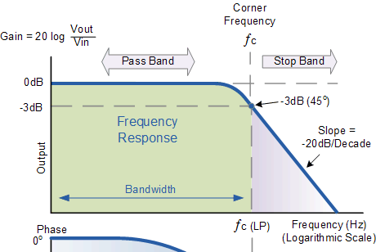
Filters are never perfect. There is “transition” from “pass” to “stop” bands
Output in the stop band is lower, but not zero.
Frequencies just above the cutoff frequency are not attenuated as effectively as those much further above.

Slide 28
Note the “decibel” notation:
dB = 20 * log_10.
Why 20, and not 10?
Because power = amplitude², so 10x amplitude increase gives 100x power increase.

Slide 29
3dB is the “half power” point:
This is where amplitude is 70.7% of max.
20 * log(0.707) = -3.01
Power = amplitude², and (0.707)² = 0.5

Slide 30
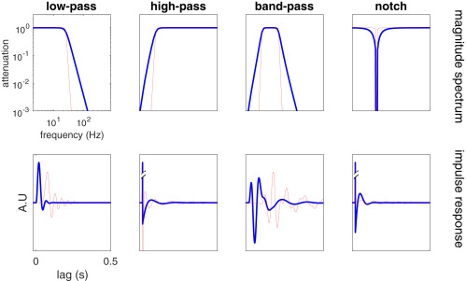
Other standard filter types
Any shape is possible, including multiple pass bands, or arbitrary shapes.
“Roll-off” rate varies with filter type - can be shallow or steep.

Slide 31
Before vs after:
kernel = signal.firwin(n, cutoff_frequency*2/sampleRate, pass_zero = False)
output = np.convolve(wave, kernel);
Notes:
This works like a charm. Before filtering, the background noise ranges over several millivolts, while spikes are only about 300 microvolts.
After filtering, background noise is about 100 microvolts, while spikes are still about 300 microvolts.
We removed a lot of stuff, and drastically reduced the background noise while spikes are almost the same height as before.

Slide 32
Voltage histograms
Before filtering
After filtering
Background
Background
Detection threshold
Spike peaks
True negatives
False negatives
Spikes
Voltage (mV)
True positives
Voltage (mV)
False positives
Notes:
These are histograms of the voltage ranges. Before filtering, background and spikes range over several millivolts, and overlap.
After filtering, spike peaks are separable from background voltages. We can draw a somewhat arbitrary vertical threshold (blue dotted line) that “detects” most of the spikes while “rejecting” most of the background.

Slide 33
Log vs linear plots. >99.99% separation
More selective
More permissive
Background
Detection threshold
Spike peaks
Detection threshold
Log probability density
Probability (linear)
Spike peaks
Background
True negatives
False negatives
True positives
Voltage (mV)
False positives
~99.99% separation
Notes:
These are histograms of the voltage ranges. Before filtering, background and spikes range over several millivolts, and overlap.
After filtering, spike peaks are separable from background voltages. We can draw a somewhat arbitrary vertical threshold (blue dotted line) that “detects” most of the spikes while “rejecting” most of the background.

Slide 34
99.99% separation is awesome. Let’s look at a noisier example:
More selective
(Fewer false positives,
but also more false negatives)
More permissive
Fewer false negatives,
but also more false pos.)
Spikes
Background
True negatives
False negatives
Detection threshold
Voltage (mV)
Notes:
These are histograms of the voltage ranges. Before filtering, background and spikes range over several millivolts, and overlap.
After filtering, spike peaks are separable from background voltages. We can draw a somewhat arbitrary vertical threshold (blue dotted line) that “detects” most of the spikes while “rejecting” most of the background.

Slide 35
“Receiver operator characteristic” (ROC) expresses tradeoff
More selective
(Fewer false positives,
but also more false negatives)
More permissive
Fewer false negatives,
but also more false pos.)
More permissive
Spikes
Background
More selective
Detection threshold
True positives
Voltage (mV)
False positives
Notes:
These are histograms of the voltage ranges. Before filtering, background and spikes range over several millivolts, and overlap.
After filtering, spike peaks are separable from background voltages. We can draw a somewhat arbitrary vertical threshold (blue dotted line) that “detects” most of the spikes while “rejecting” most of the background.

Slide 36
“Receiver operator characteristic” (ROC) expresses tradeoff
More selective
(Fewer false positives,
but also more false negatives)
More permissive
Fewer false negatives,
but also more false pos.)
More permissive
Detection threshold
Spikes
Background
More selective
True positives
Voltage (mV)
False positives
Notes:
These are histograms of the voltage ranges. Before filtering, background and spikes range over several millivolts, and overlap.
After filtering, spike peaks are separable from background voltages. We can draw a somewhat arbitrary vertical threshold (blue dotted line) that “detects” most of the spikes while “rejecting” most of the background.

Slide 37
Filtering greatly improved detection, but still far short of perfection
Perfect classification:
Detect 100% of signal, 0% of background.
Can’t get here with this dataset.
More permissive
After filtering
Before filtering
y=x, random classification
More selective
Detecting ~25% of spikes, and ~5% of noise.
Highest signal/noise ratio (5:1).
p = 0.05 (publication standard)
Notes:
These are histograms of the voltage ranges. Before filtering, background and spikes range over several millivolts, and overlap.
After filtering, spike peaks are separable from background voltages. We can draw a somewhat arbitrary vertical threshold (blue dotted line) that “detects” most of the spikes while “rejecting” most of the background.

Slide 38
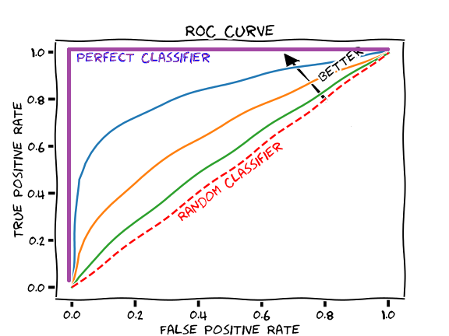
Filtering is big help, but to go further you usually need a better experiment (e.g. better technology, or move probe closer to neurons)

Slide 39
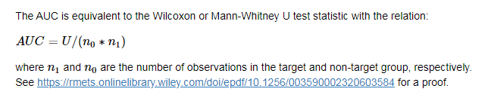
Area under curve (AUC) is proportional to Mann-Whitney “U”
Notes:
These are histograms of the voltage ranges. Before filtering, background and spikes range over several millivolts, and overlap.
After filtering, spike peaks are separable from background voltages. We can draw a somewhat arbitrary vertical threshold (blue dotted line) that “detects” most of the spikes while “rejecting” most of the background.

Slide 40
Python code:
kernel = scipy.signal.firwin(n, cutoff_frequency*2/sampleRate, pass_zero = False)
output = np.conv(input_signal, kernel);

Slide 41
“firwin” arguments:
kernel = scipy.signal.firwin(n, cutoff_frequency*2/sampleRate, pass_zero=False)
n is filter “order”
cutoff_frequency is half-power frequency (transition from pass to stop bands)
Pass_zero: True for low-pass filter, false for high-pass.

Slide 42
“firwin” arguments:
kernel = scipy.signal.firwin(n, cutoff_frequency*2/sampleRate, pass_zero=True)
pass_zero = True for a low-pass filter, False for high-pass
True
False

Slide 43
“conv” function arguments:
kernel = fir1(n, cutoff_frequency*2/sampleRate, pass_zero=True)
output = np.convolve(input_signal, kernel);
“w” is the “impulse function”
“convolve” takes two inputs, and produces a filtered output.

Slide 44
Higher filter order n gives sharper transition
N=2
N=5
N=10
N=20
N=100

Slide 45
Low-pass filter
N=2
N=5
N=100

Slide 46
But: high order filters produce delays and other distortions
After
filter
Before
filter
Output is time-delayed (easy to compensate).
Biphasic waveform might become triphasic (NOT easy to correct)
High-order filters distort more than low order
High-pass filters distort more than low-pass.
Notes:
The original spike (brown) is shifted in time and is now triphasic instead of biphasic. Actually, it is almost quadruphasic, as there is a slight backlash to the initial AHP.
The time shift is easy to fix – just subtract. The distortion is much harder to fix. Theoretically you can run it back through a lowpass filter, but that brings back some of the noise you got rid of.
Distortion may or may not be a problem. This depends on the question you are asking. If you just want to know firing rate and spike latency, you don’t have to worry.

Slide 47
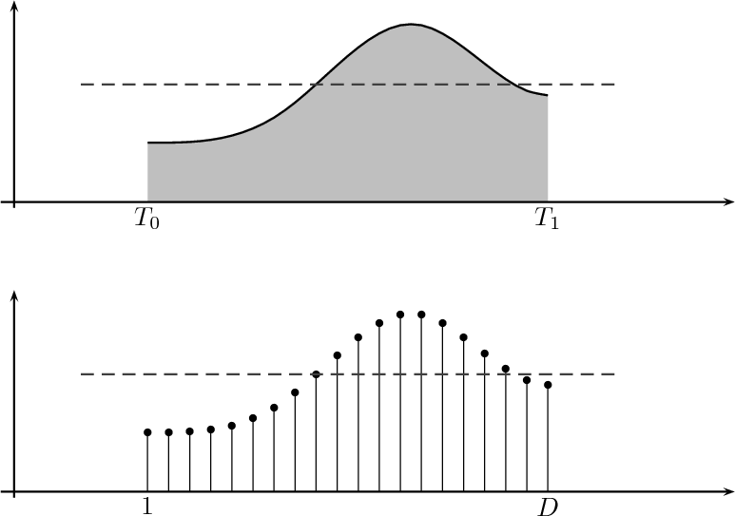
Another distortion:
Real-world signals (from the brain) are continuous, but computers process signals that are “sampled” at a finite rate
time
time

Slide 48
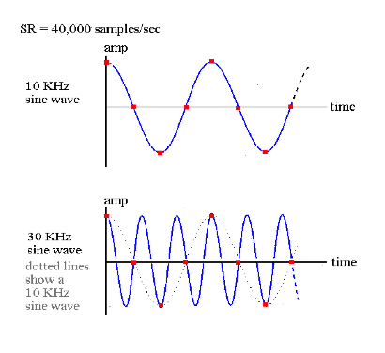
“Aliasing” occurs if sample rate is too low
Sine wave = 10kHz.
Sample rate = 40kHz (4x)
GOOD!
Sine wave = 30kHz.
Sample rate = 40kHz (1.33x)
BAD!
Notes:
Note that the 30kHz wave looks exactly like the 10kHz wave when sampled at 40kHz. This is the “aliasing”, where one wave looks like another.

Slide 49
Aliasing
At 40kHz sample rate,
10kHz, 30kHz look same
5kHz, 35kHz look same
1Hz, 33,999Hz look same
x and 40kHz – x
Max detectable frequency is 20 kHz: “Nyquist” frequency

Slide 50
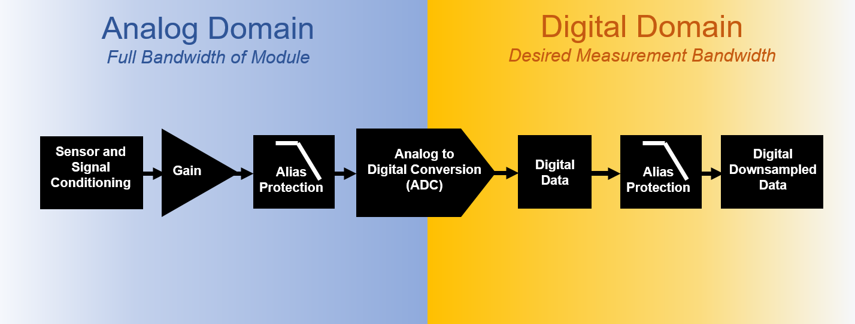
Typically need analog filter before digital sampling
Low-pass ANALOG filter
https://community.sw.siemens.com/s/article/data-acquisition-anti-aliasing-filters

Slide 51
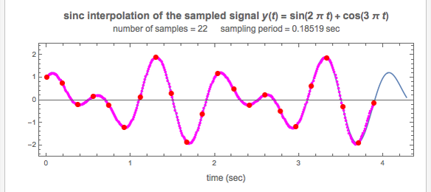
If frequencies < Nyquist, original wave can be interpolated perfectly from samples (via sinc function)
Blue = original signal. Red dots = sampled.
Magenta = interpolated from samples using sinc function.
https://demonstrations.wolfram.com/SincInterpolationForSignalReconstruction/

Slide 52
Homework, due in 1 week
Update the github repository. You should see a folder called Class2, and a Python file called Homework2.py
Task 1: write code to remove the noise and identify the underlying musical piece.
Task 2: Plot Fourier transforms of wave before and after filtering.

Slide 53
The end. Ignore any slides after this one.

Slide 54
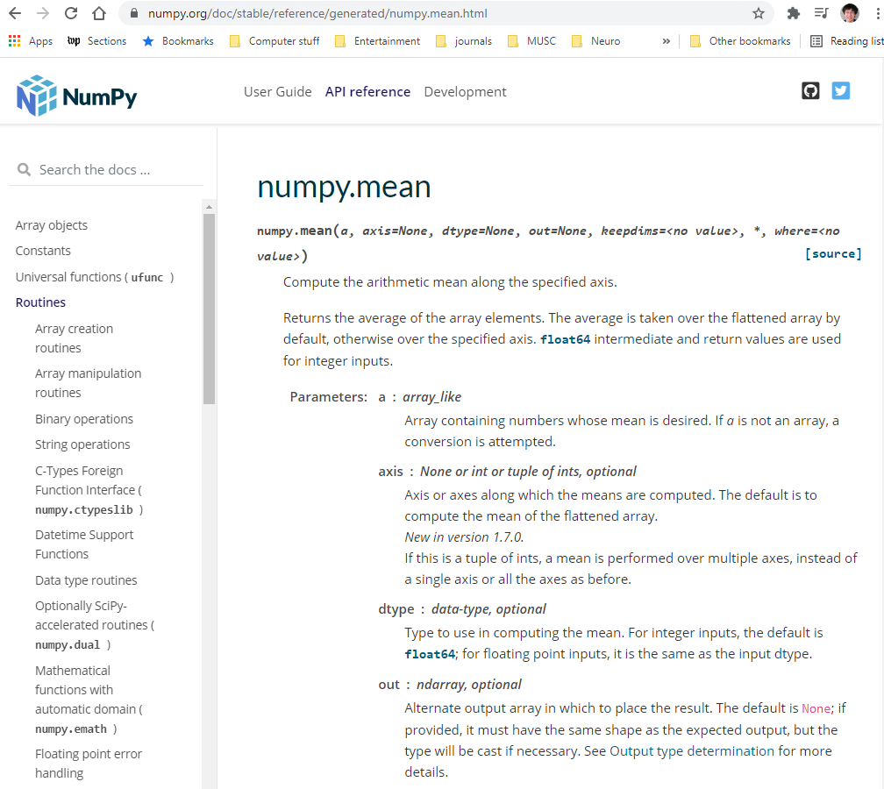
A few notes about Python functions:
Package name
Function name

Slide 55
Arguments are distinguished by their position (1st, 2nd, 3rd) or name:
First argument (no name)
2nd argument (named)
3rd argument (named)

Slide 56
Named arguments can be in any order:
np.mean(calcium, axis = 0, dtype = np.float32)
np.mean(calcium, dtype = np.float32, axis = 0)

Slide 57
Skipped arguments take default value:
Default values if skipped

Slide 58
Another common way to call functions:
np.mean(calcium, axis = 0)
# The following is functionally equivalent:
calcium.mean(axis=0)
This works because of something called “object oriented programming”.

Slide 59
Think of “objects” as “smart” variables:

Slide 60
The code:
% Generate/plot 5 Hz square wave
t = np.arange(100)/100
y = scipy.signal.square(t*5*2*pi);
np.step(t, y)
% Calculate/plot FFT
f = np.fft.fft(y);
np.plot(abs(f))
waveform
FFT
Notes:
The function is easy to call, but you have to pay careful attention to the details of the frequencies that come out.

Slide 61
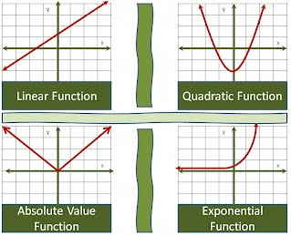
Convolution, FFT, are all “linear” functions

Slide 62
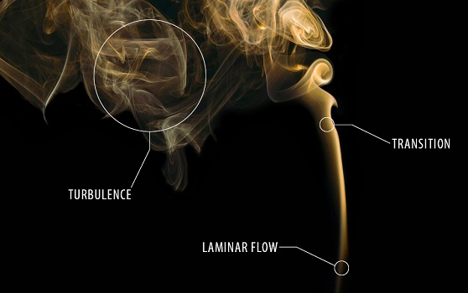
Much of nature is non-linear
But non-linear math is freakishly complex, so we try to make linear approximations wherever possible.
Many things are linear, up to a point.

Slide 63
Algebraic definition of linearity:
All terms square and higher are zero:
$$f\left(x\right)=a+bx+cx^{2}+dx^{3}+gx^{4}+{hx}^{5}+…$$

Slide 64
Most general definition of linearity
A function f is linear if and only if:
f(x + y) = f(x) + f(y) f (of sums) = sum (of f’s)
af(x) = f(ax) Scalability
Notes:
If you want to convolve A with the sum of B and C, you can break it into two easier tasks. First convolve A with B, then A with C, then add the two results.
All linear functions are handy this way, they can always be broken down into parts, solved independently, then added back together.

Slide 65
Good overview of filtering:
https://www.sciencedirect.com/science/article/pii/S0896627319301746

Slide 66
Why “abs”?
% Calculate/plot FFT
f = fft(y);
plot(abs(f))
FFT
Notes:
The function is easy to call, but you have to pay careful attention to the details of the frequencies that come out.

